Slide 1
Using Models
Muhammed

Slide 2
Learning Aims and Outcomes
Learning Aim: To begin to understand how to use models and link them to your views
Learning Outcomes:
  To be able to create models in Visual Studio 2022
  To be able to use migrations to establish a database
  To be able to scaffold views and controllers in Visual Studio 2022

Slide 3
Starter
Create a new web application project called – MVCMovies
Make sure to setup the project correctly

Slide 4
Creating a New Model

Slide 5
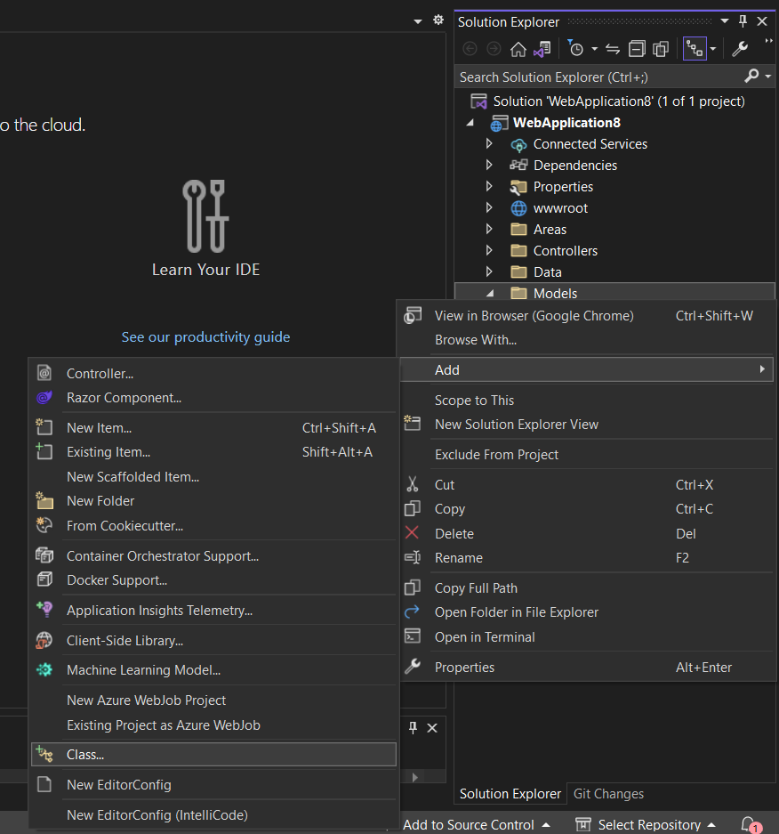
Right Click Models Folder -> Add-> Class -> Movie.cs

Slide 6
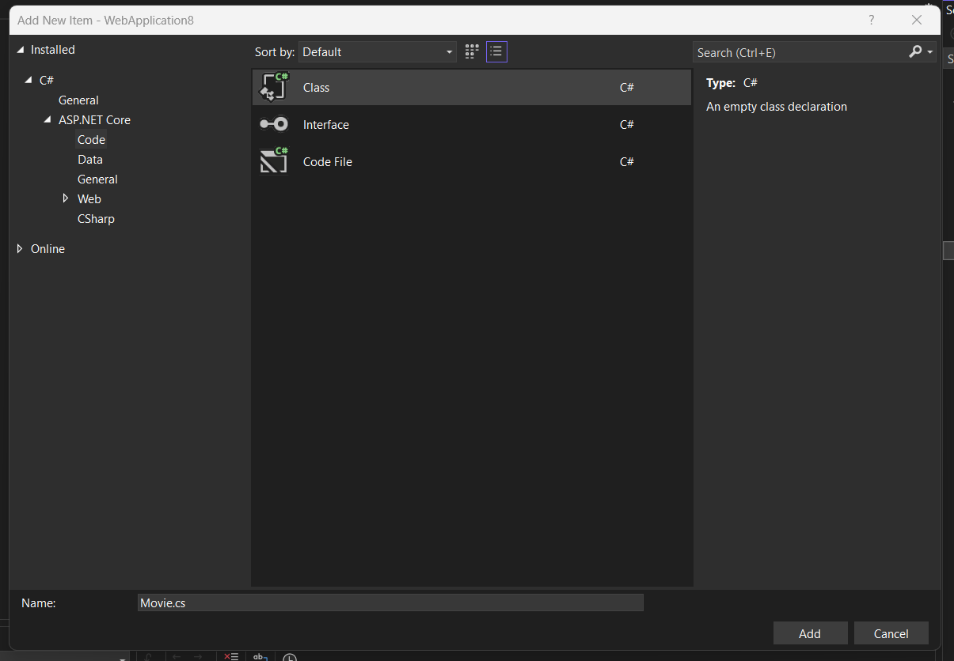

Slide 7
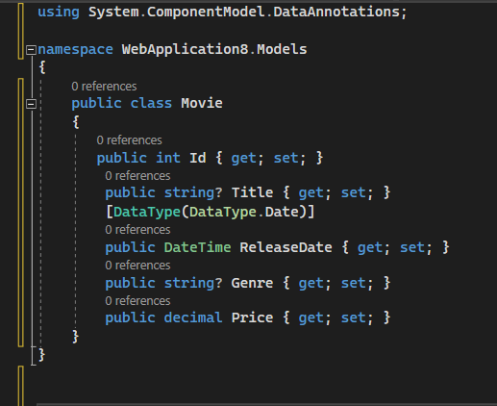
Now we need to create the model

Slide 8
Scaffolding
CRUD
Create
Read
Update
Delete

Slide 9
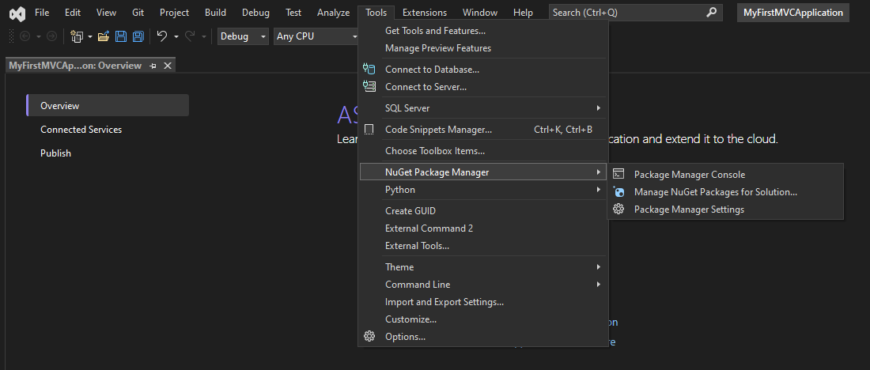
Open Package Manager Console

Slide 10
In the Console, Install the Packages
Install
Install-Package Microsoft.VisualStudio.Web.CodeGeneration.Design
Install
Install-Package Microsoft.EntityFrameworkCore.Design
Install
Install-Package Microsoft.EntityFrameworkCore.SqlServer

Slide 11
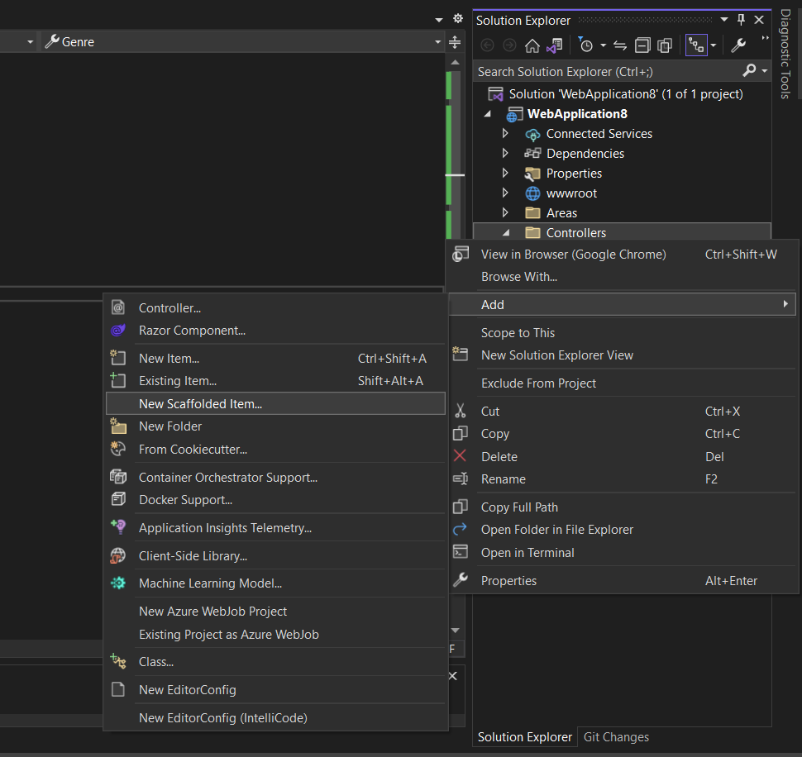
Right click Controllers -> Add -> New Scaffolded Item

Slide 12
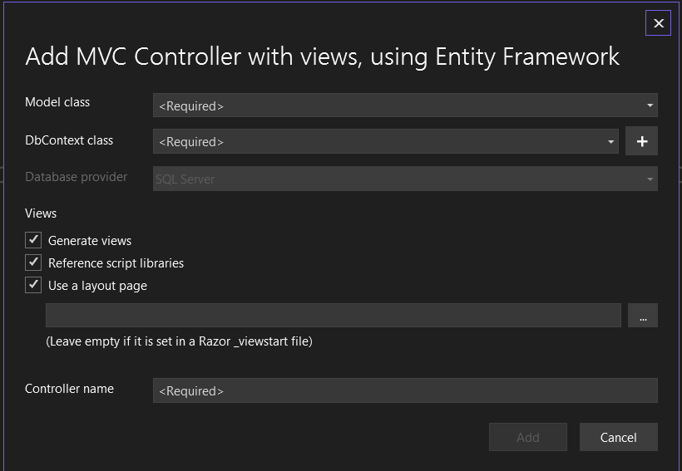
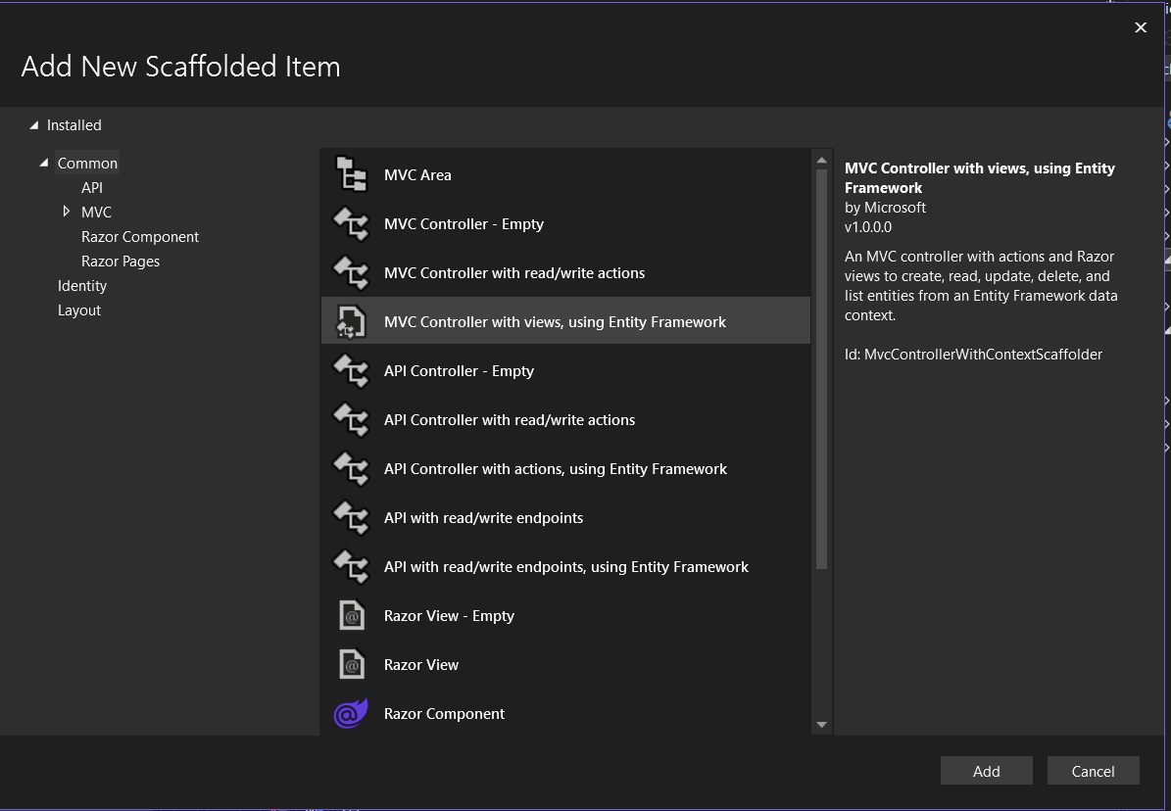
Select MVC Controller with views, using Entity Framework

Slide 13
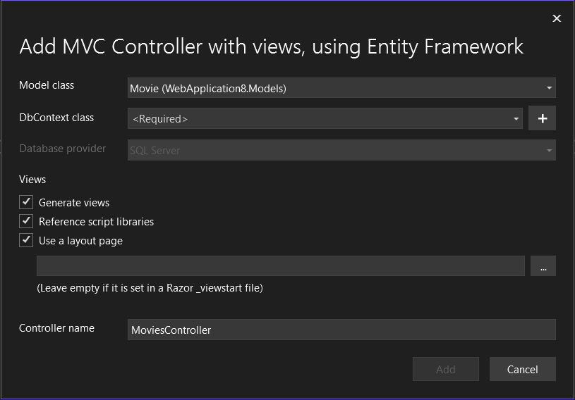
Select the Model Class you want to base the views on -> Movies.cs

Slide 14
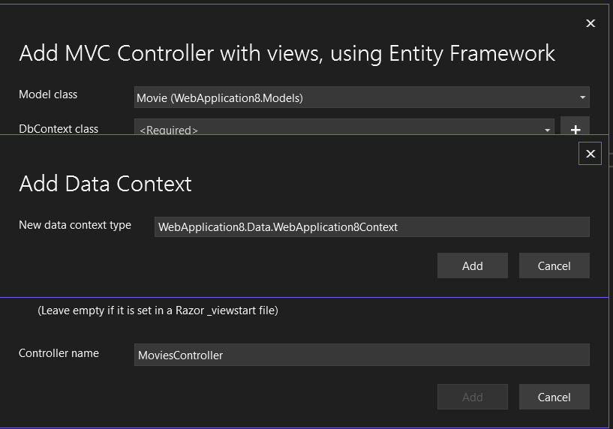
Time to create a DBContext = Database

Slide 15
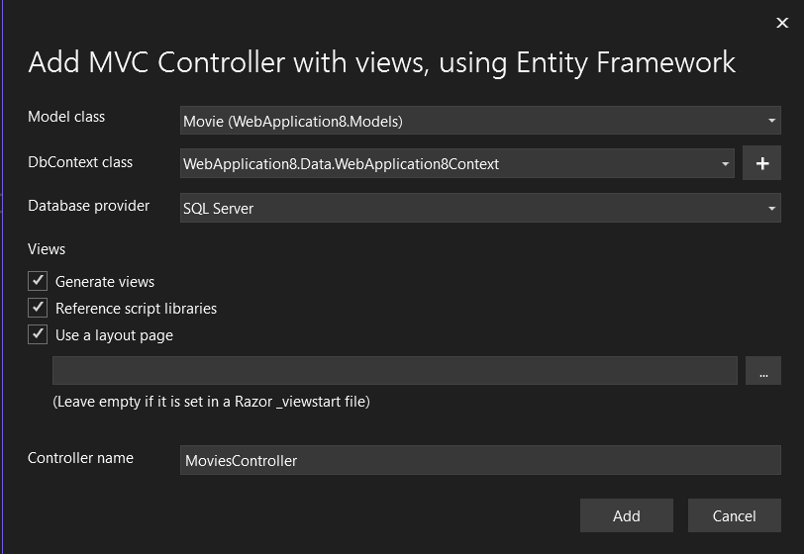
You are now ready to add the views – This may take some time.

Slide 16
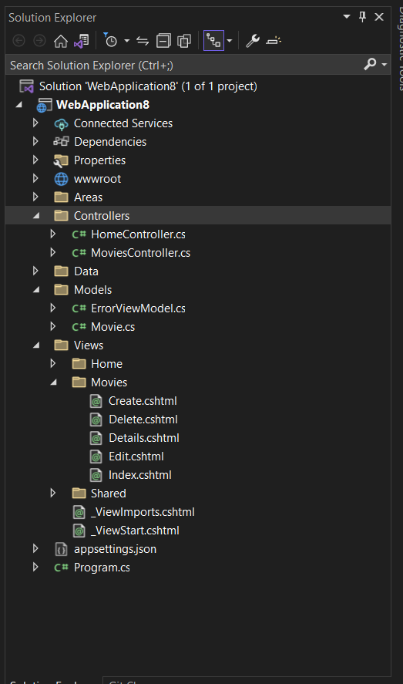
This should be your new folder structure with a Controller and Views made for you

Slide 17
Run the program and attempt to navigate to /Movies

Slide 18
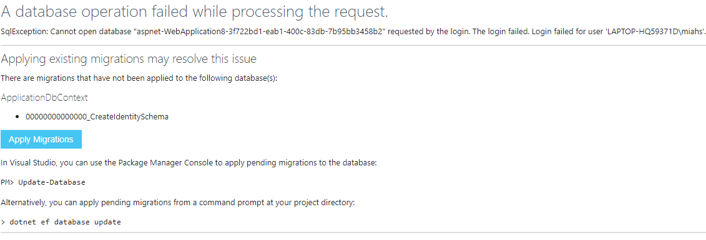
Should get an Error – Need to make the database first

Slide 19
Migrations

Slide 20
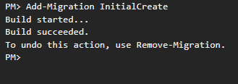
Run the Following Command -> Add-Migration InitialCreate

Slide 21
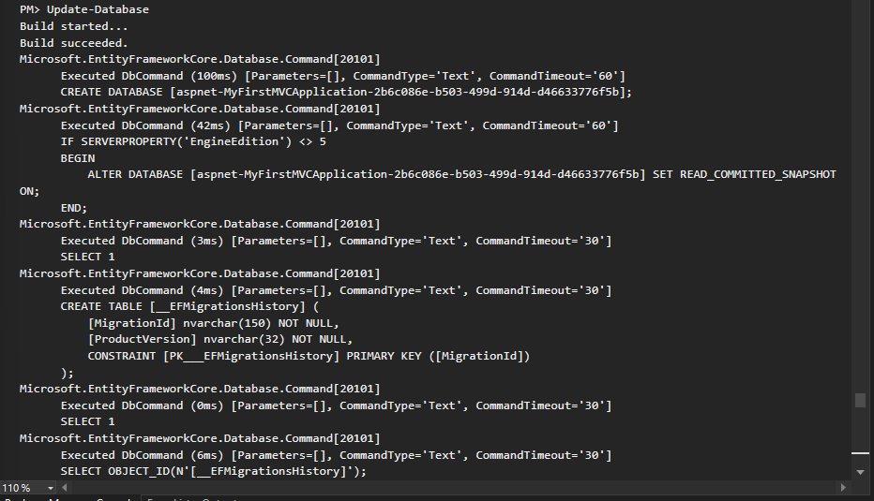
Now run the Update Database Command

Slide 22
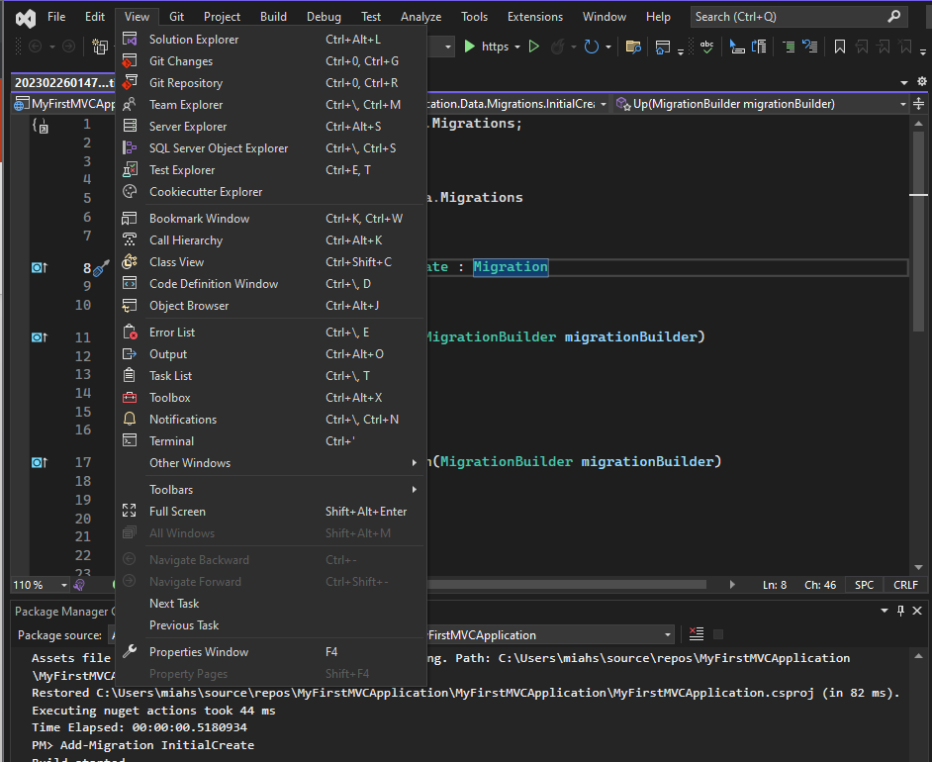
Open the Database Design using the SqlServerExplorer to check if it has been made

Slide 23
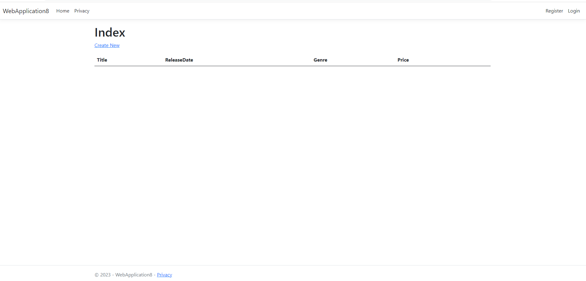
Now Run the website and test it out adding movies and more

Slide 24

Activity
The Client would now like to expand the website to store information about the following;
  Books
  Authors
  TV Shows
  Actors
  Movies
  Video Games

